Slide 1
Base Project Report II
Technology Sales Website Interface Design
Instructor : Ts.Than Hong Phuc
Students perform : Dinh Huu Duc 20NS
: Nguyen Thi Minh Chung 20MC

Slide 2
Project content
Reason for choosing the topic, Purpose and requirements of the topic
System Analysis & Design
Deployment Tools
Program results
Summary

Slide 3
I. The reason for choosing the topic, purpose and requirements
Reasons for choosing the topic
The number of Internet users in Vietnam is increasing
Construction purpose
Building sales channels for the company
Brand development for the company
Customer care and support
Request
Experience in building websites
Support online ordering on the website
Notes:
According to a survey by WeAreSocial and Hootsuite in 2021, Vietnam has 68.72 million internet users, 77% of which have ever participated in online shopping.

Slide 4
II.System Analysis & Design
Usecase Diagram
Class Diagram
Activity diagrams and State diagrams
Sequence diagrams and communication diagrams

Slide 5
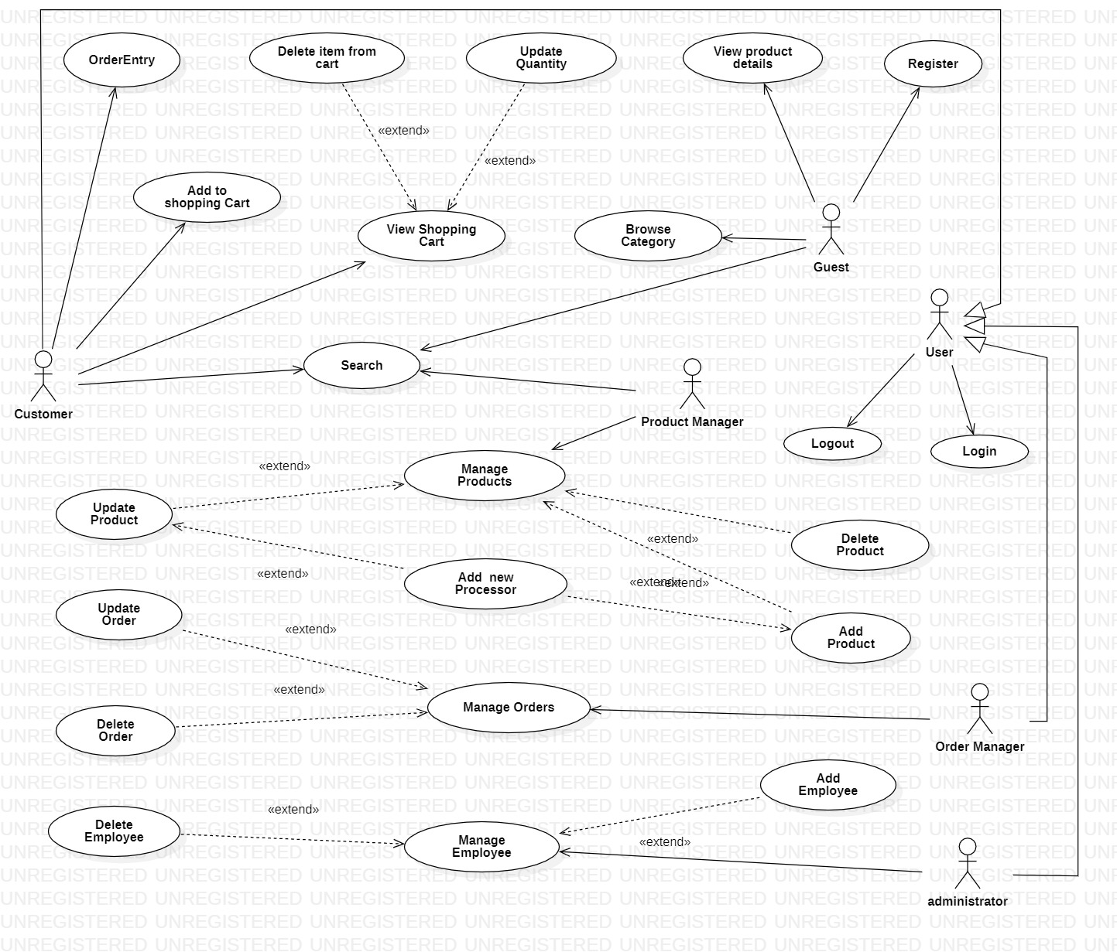
Usecase Diagram

Slide 6
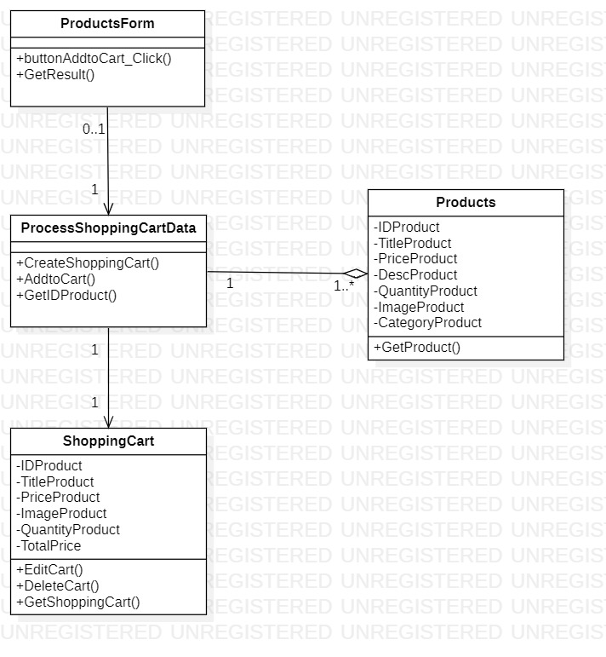
Class Diagram
Add to Shopping Cart

Slide 7
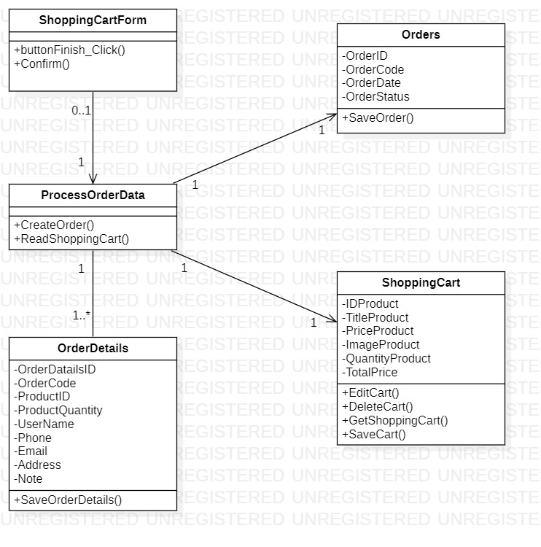
Class Diagram
Order Entry

Slide 8
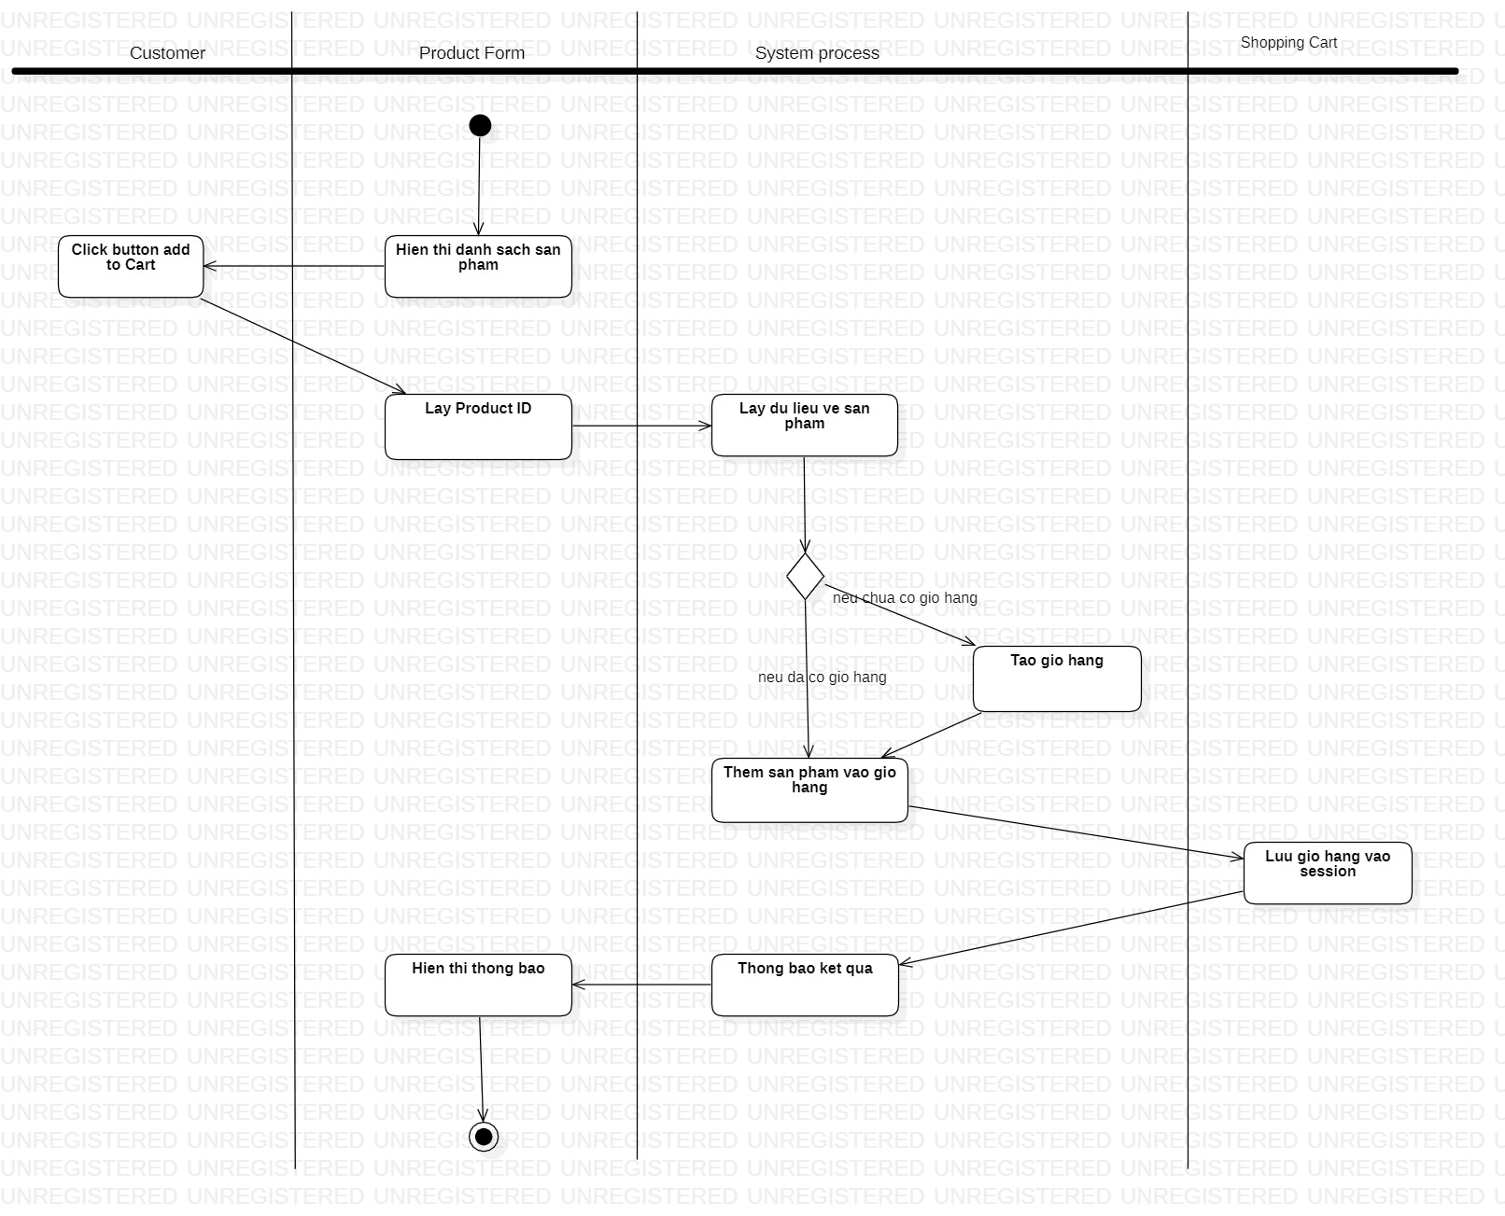
Activity diagrams and State diagrams
Activity diagrams add to Shopping Cart

Slide 9
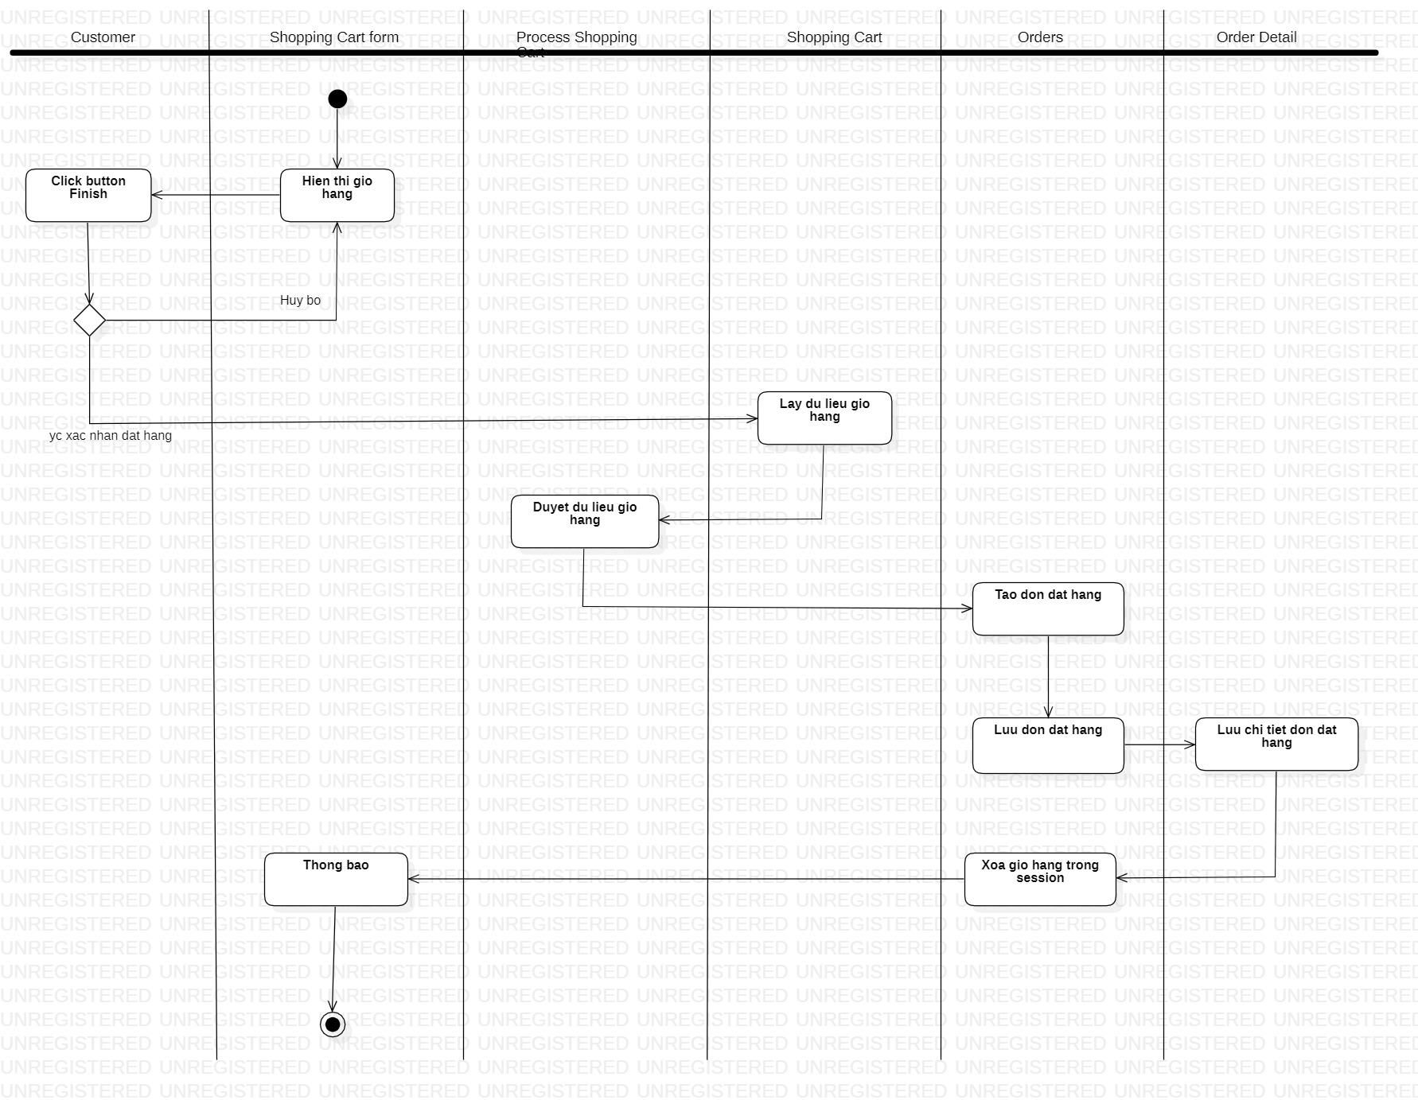
Activity diagrams and State diagrams
Activity diagrams Order Entry

Slide 10
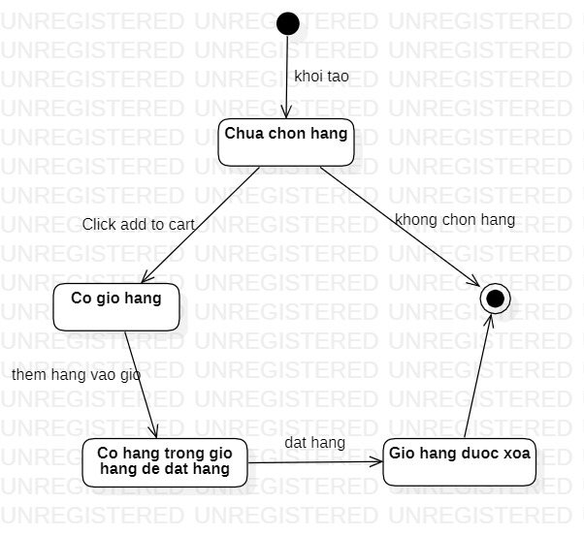
Activity diagrams and State diagrams
State diagrams add to Shopping Cart

Slide 11
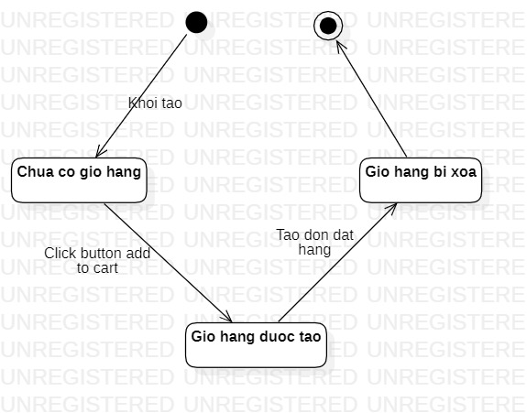
Activity diagrams and State diagrams
State diagrams Order Entry

Slide 12
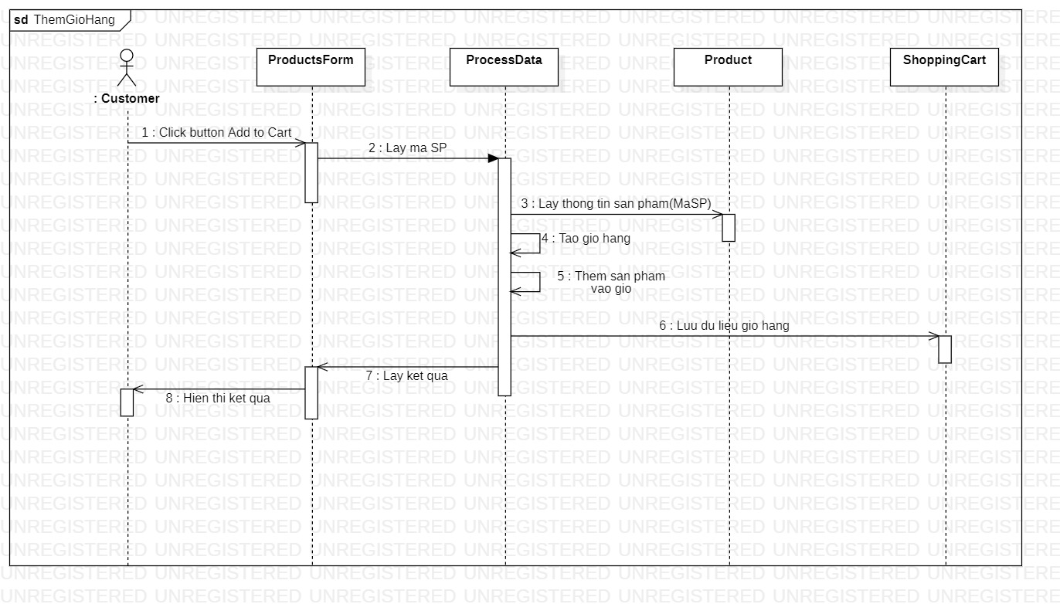
Sequence diagrams and communication diagrams
Sequence diagrams add to Shopping Cart

Slide 13
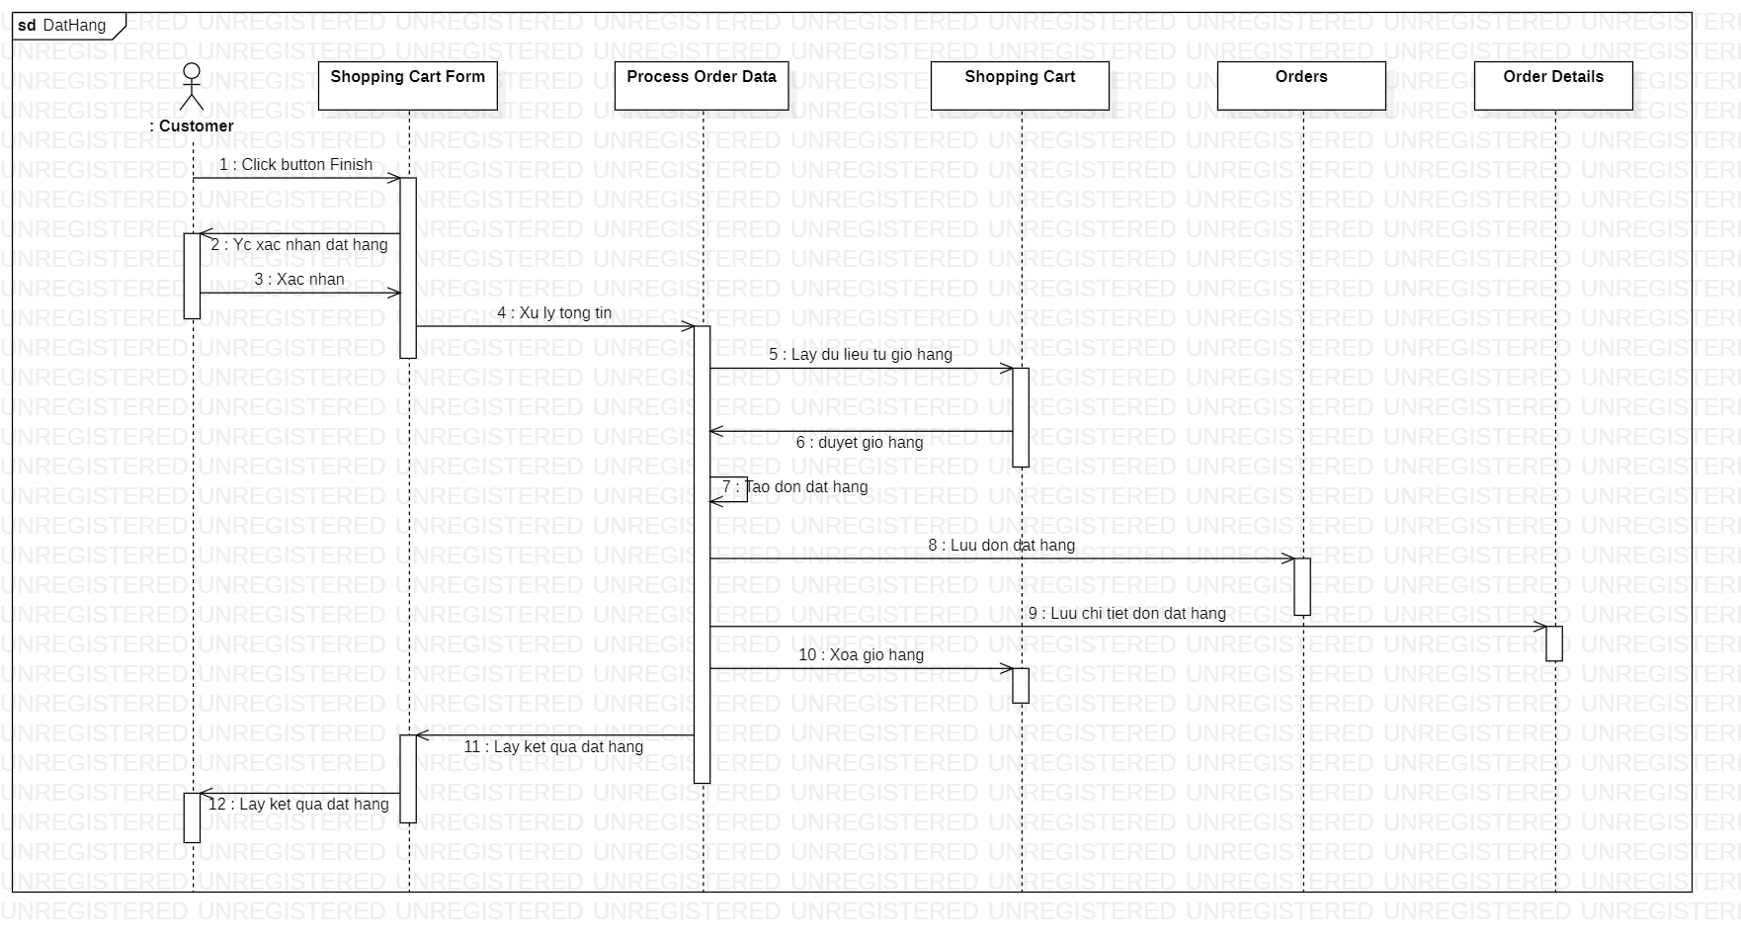
Sequence diagrams and communication diagrams
Sequence diagrams Order Entry

Slide 14
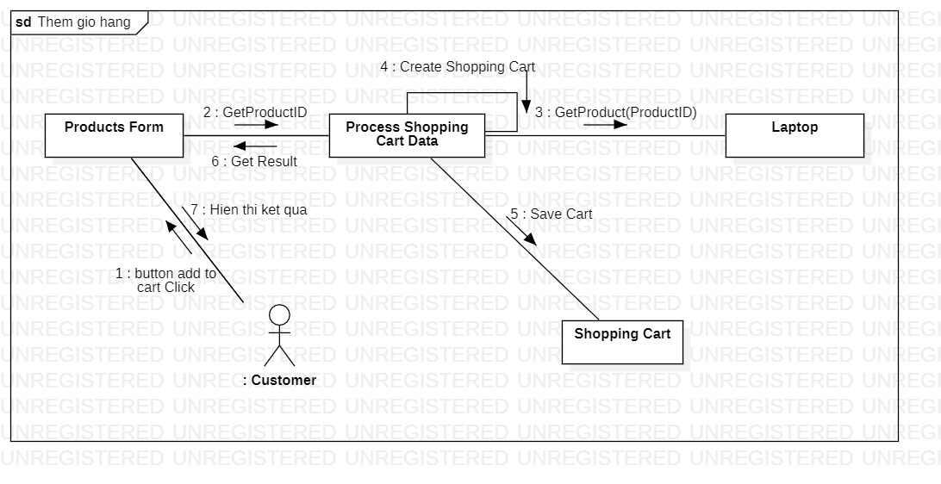
Sequence diagrams and communication diagrams
Communication diagrams add to Shopping Cart

Slide 15
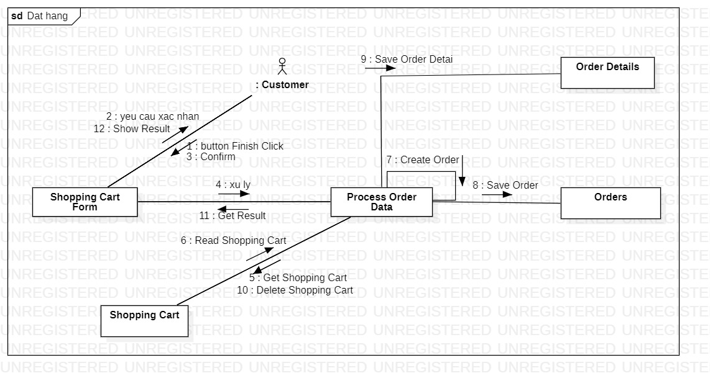
Sequence diagrams and Communication diagrams
Communication diagrams Order Entry

Slide 16




III. Deployment Tools
Zend Studio
Visual Studio Code
Bootstrap
XAMPP

Slide 17
IV. Program results
Manage product list
Manage news lists
Manage product reviews
Manage comments on news
Manage member
Order online
Bill management
Order processing
Order statistics
Warehouse statistics
Member Statistics

Slide 18
V. Summary
Things that have been achieved
Website development direction
Friendly interface
Meet the basic business requirements of the sales process
Information is stored scientifically, processed easily and accurately
Online ordering support
Support online payment
Build more promotional methods
Support for new payment methods
Need stricter control when ordering

Slide 19
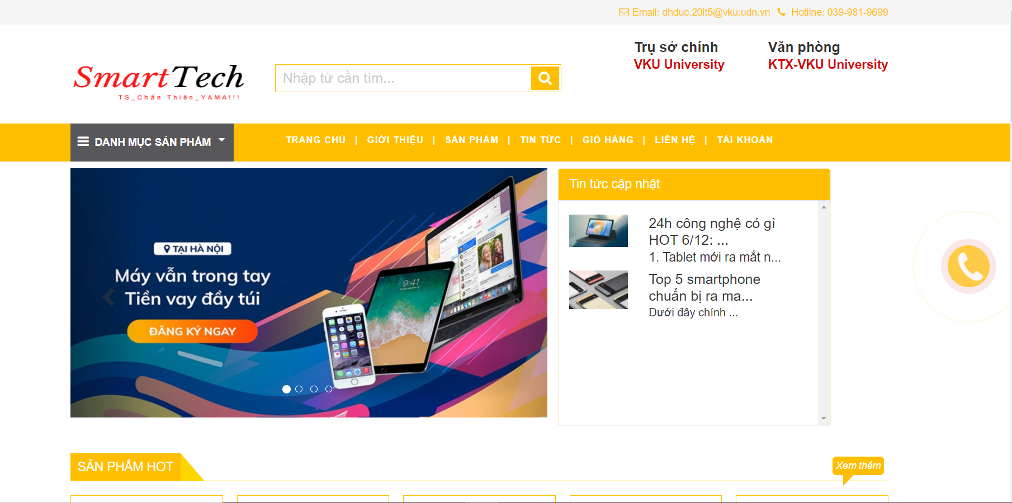
Some interface of the program

Slide 20
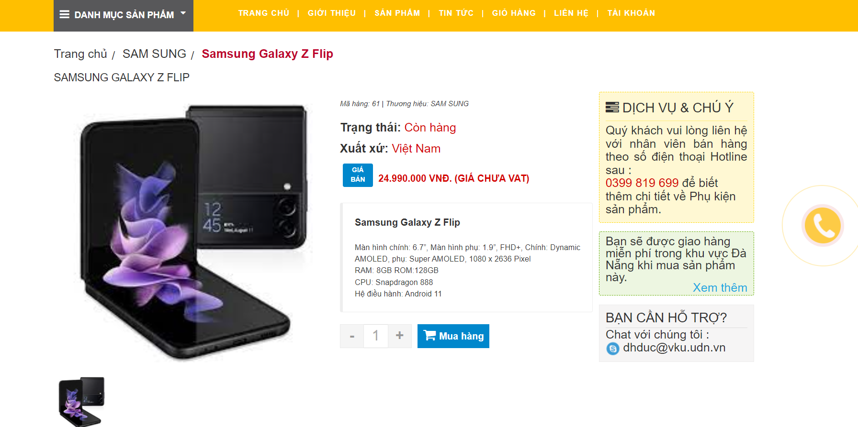
Some interface of the program

Slide 21
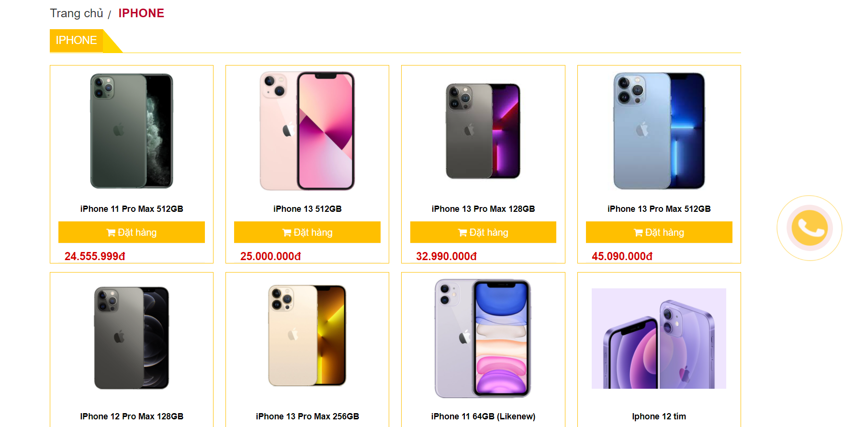
Some interface of the program

Slide 22
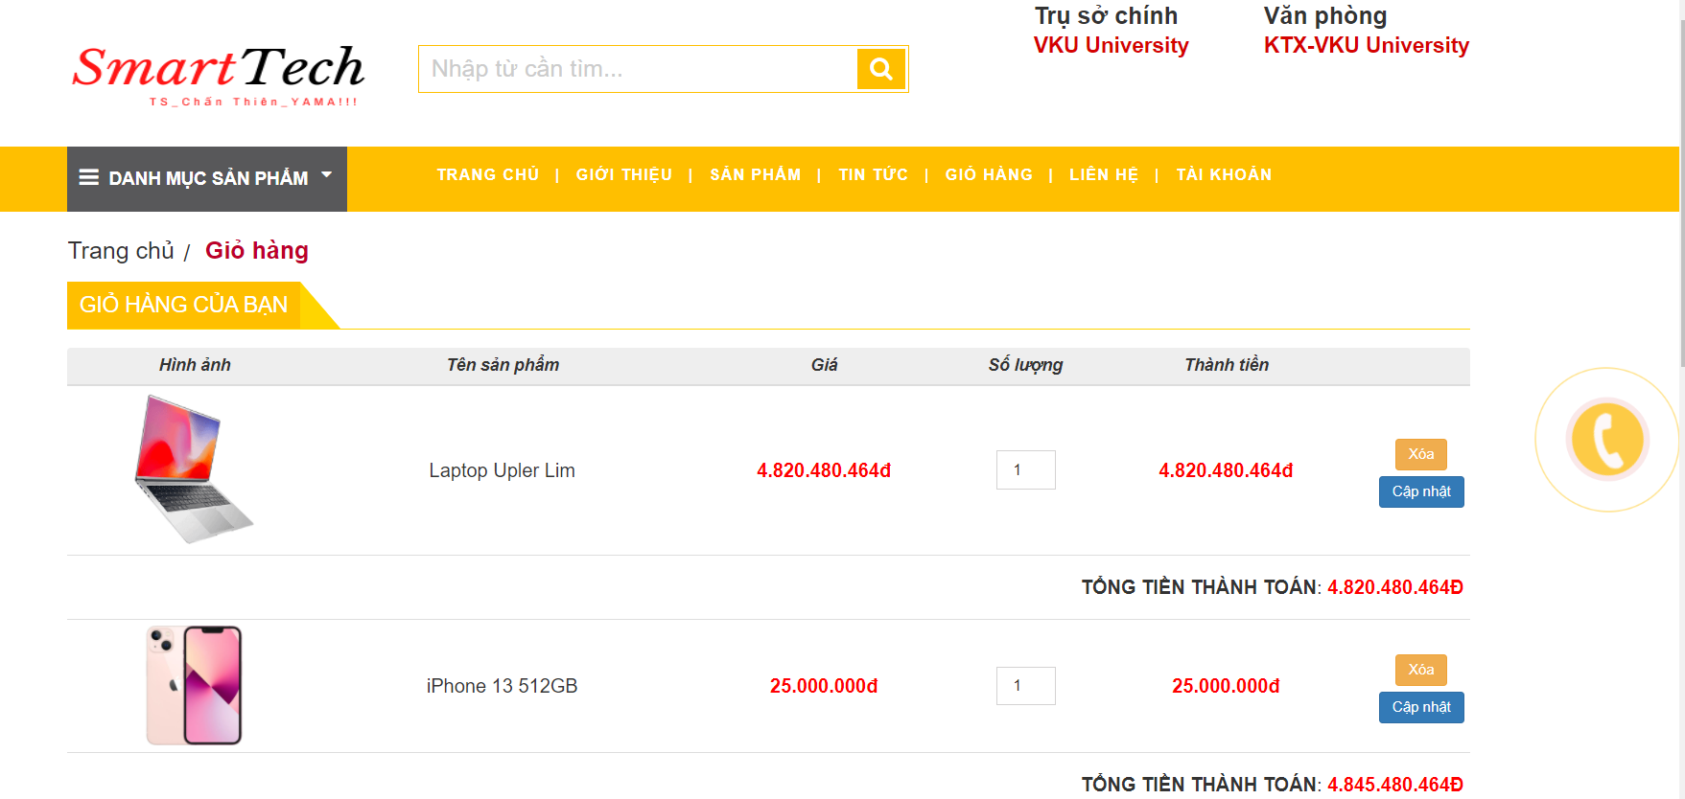
Some interface of the program

Slide 23


Slide 24


